Slide 1
New Requirements and Procedures Postdoc Benefits Training
Presented by
Nadine Fishel UCOP Labor Relations
Jeff Ho UCOP Benefits
Steve Johnson Garnett-Powers & Associates

Slide 2
Nadine Fishel UCOP Labor Relations
Settlement Agreement
New Requirements - Appointment Process
New Reporting Obligations – Fellows Institutional Allowance

Slide 3
Case Background
Grievances filed claiming Postdoc Fellows and Paid Directs were told they had to pay some or all of the employer’s share of benefits.
Three categories:
Postdocs who paid part or all of UC share;
Postdocs who opted out;
Fellows who had benefits paid out of the Institutional Allowance.
UC and the UAW agreed, after hours of discussion and review of the 150 cases, to settle.

Slide 4
Monetary Settlement
Postdocs who paid part or all of UC share
- Will receive .50 cents on the $1.00 (half of what was claimed)
Postdocs who opted out
- Will receive .50 cents on the $1.00 (half of what was claimed)
Fellows who had benefits paid out of the Institutional Allowance
- No change from current practice (none of what was claimed)
Tax Consequences: settlement earnings may be subject to imputed income as well as federal and state withholding tax.

Slide 5
Non-Monetary Settlement
Agreed Upon language for appointment letters
Consistent and accurate benefits information for Postdocs:
Offer letters
Appointment letters
Websites (campus-wide or departmental)
Use of Appendix A – 2014 Benefits Chart and Costs
Appointment letters
Initial hire paperwork
Consequences of UC providing misinformation
UC will seek to enroll the Postdoc and/or dependents late IF:
The Postdoc never received a form explaining the consequences of the decision not to enroll
The signed form exists but cannot be produced as evidence of the informed decision.

Slide 6
Importance of Notification
Postdocs must make a decision about enrolling in benefits the first 31 days of employment.
If the Postdoc fails to sign up, the University must have the Postdoc sign the OPT OUT portion of the form and keep it on file.
If the Postdoc is informed and does not sign up, then s/he subsequently wants to do so, there is a 90 day waiting period for medical plan coverage.
Postdocs may also enroll during Open Enrollment in the Fall, with coverage beginning the following January.

Slide 7
Benefits Process
Postdoc gets offer from UC
Appointment Letter
Contains benefits language specific to Paid Directs or Fellows and a copy of 2014 Appendix A.
Direct to Garnett Powers website
Postdoc signs up for benefits
Initial Hiring Paperwork
Include Appendix A
Enrollment Form explaining options
31 day for PIE
Properly informed Postdoc
Postdoc fills out OPT OUT portion of enrollment form

Slide 8
Appointment Letters
Postdoctoral Fellows (Title Code 3253s)
Include mandated language regarding Benefits
Include language noting the following:
“The University may deduct the cost of health benefits from funding provided to the University in the grant. Notice of such deduction will be provided no later than 30 days prior to the deduction. You will have the right to request and receive a copy of your budget from your Principal Investigator or Research Administrator.”

Slide 9
Appointment Letters
Postdoctoral Paid Directs (Title Code 3254s)
Include mandated language
Include language noting the following:
“The University may deduct the cost of health benefits from funding provided to the University directly from the funding agency or shall bill the postdoc directly, if allowed by the funding agency. Notice of such deduction or billing will be provided no later than 30 days prior to the deduction or billing. You will have the right to request and receive a copy of your budget from your Principal Investigator or Research Administrator.”
Sample Letters

Slide 10
Appendix A

Slide 11
Institutional Allowances
Commonly, Postdoc Fellows will be provided with funding for miscellaneous expenses.
Benefits
Travel
Moving
Such funding may be charged for the University’s share of benefits costs, if allowable under the rules of fellowship and granting agency.
Key Issue: Postdoc is entitled to notice of such a deduction and to receive an accounting of expenses.
Paid Directs may also have funding equivalent to an institutional allowance. If they do, these provisions apply to them as well.

Slide 12
Deductions to Institutional Allowance (applies to Fellows and some Paid Directs)
Notice
Provide 30 days notice to the Postdoc Fellow prior to the deduction
Retroactive deductions are acceptable, provided there is appropriate notice and a reasonable basis for the retroactive adjustment.
Include who Postdoc should contact (PI, research administrator, lab manager, or other) to request and receive a copy of fellowship budget

Slide 13
Sample Notice
To: Polly Postdoc
From: Roger Research
CC: Principal Investigator
Subject: Institutional Allowance Deductions
_______________________________________________________
Dear Dr. Postdoc:
Welcome Aboard! Beginning September 1, 2014, the Department will deduct $472.65 each month from your institutional allowance to cover the University’s portion of your Health Net HMO benefit.
If you want to review the budget or receive an accounting of your institutional allowance, you may request a copy through me at any time.
Roger

Slide 14
Jeff Ho UCOP Benefits
Review of Postdoc Benefits
Benefit Eligibility
Family Member Eligibility
Contribution Levels

Slide 15
Postdoc Title Codes
Title Code 3252 - Postdocs paid through the UC payroll system have been appointed in the title “Postdoctoral Scholar-Employee”.
Title Code 3253 - Postdocs paid a stipend have been appointed in the title “Postdoctoral Scholar-Fellow”.
Title Code 3254 - Postdocs paid directly from an extramural agency have been appointed in the title “Postdoctoral Scholar-Paid Direct”.
Note: The title of a Postdoctoral Scholar appointment is determined by the requirements of the funding agencies.

Slide 16
Benefits Offered Through PSBP
Medical Insurance – Health Net HMO and PPO
Dental Insurance – Health Net HMO and Principal POS
Vision Insurance – Health Net/EyeMed PPO
Life and AD&D Insurance – Standard Insurance
Short Term Disability Insurance – Standard Insurance
Voluntary Long Term Disability Insurance – Standard Insurance
Bright Horizons – A program that offers a variety of helpful caregiver services.

Slide 17
Postdoc Benefit Eligibility
Initial Appointment Requirements
UC-UAW Agreement requires initial appointments to be at least 1 year (Article 2) at 100% time, unless exceptional circumstances (Article 24).
Minimum Benefits Eligibility
Postdoctoral Scholar must be appointed at least three months at 100% time or 50%-99% time for at least 12 months or more.
Continuing Requirements
Postdoctoral Scholar – Employees are required to maintain an average regular paid time of at least 17.5 hours per week (43.75%).
Postdoctoral Scholar – Fellows and Paid Directs are required to maintain an appointment at a minimum of 43.75% time.

Slide 18
Family Member Eligibility
The major family member categories are the following:
Adult:
Spouse
Same-sex domestic partner
Opposite-sex domestic partner (per AB205) – If one partner is over age 62 and Social Security eligible.
Children:
Natural/Adopted up to age 26
Step child/domestic partner’s child
Grandchild or step-grandchild/domestic partner’s grandchild
Legal ward
Overage disabled child
Note: When two family members are employed through the UC, duplicate coverage is not allowed.

Slide 19
Monthly Contributions For The HMO Medical Plan
Effective 1-1-2014 Postdocs in all three Title Codes will make the following monthly contribution if enrolled in the Medical HMO Plan:
Coverage Type Monthly Contribution
Postdoc Only $9.45
Postdoc + Spouse/Domestic Partner $34.03
Postdoc + Child(ren) $16.54
Postdoc + Spouse/Domestic Partner + Child(ren) $43.25

Slide 20
Monthly Contributions For The PPO Medical Plan
Effective 1-1-2014 Postdocs in all three Title Codes will make the following monthly contribution if enrolled in the Medical PPO Plan: Coverage Type Monthly Contribution
Postdoc Only $20.00
Postdoc + Spouse/Domestic Partner $40.00
Postdoc + Child(ren) $40.00
Postdoc + Spouse/Domestic Partner + Child(ren) $60.00

Slide 21
Monthly Contributions For The Non-medical Plans
Effective 1-1-2014 Postdocs in all three Title Codes will make the following monthly contribution if enrolled in the plans:
Dental POS and HMO, Vision, Life and AD&D, and Short Term Disability are fully paid by the University
Voluntary Long Term Disability: $7.95

Slide 22
Steve Johnson Garnett-Powers & Associates
The Enrollment Process
Future Enrollment Enhancements
The Collection Process
Non-Payment of Contributions
Reminders
Resources

Slide 23
The Enrollment Process
The Postdoc should go to the Garnett-Powers & Associates (GPA) website at www.garnett-powers.com/postdoc and click on the “Enrollment” link. By clicking on this link the postdoc will be asked a series of questions that will determine which of two methods they will use to enroll in the PSBP. Postdocs must do this within 31 days of their hire date.
If they answer “yes” to one of the questions it will bring them to the “Enrollment Page”. Once they have completed the enrollment form, they need to sign it, date it and turn it into their UC department administrator for processing. Postdocs should always keep a copy for their own records as well. It may take up to 6 weeks for the information to reach the carriers. If the postdoc needs to seek services during this time, they can contact Garnett-Powers & Associates. Again, postdocs have 31 days from their hire date or qualifying event (such as a marriage or a birth) in order to enroll in the PSBP.

Slide 24
The Enrollment Process, cont.
Administrators should require Postdocs who are opting not to enroll in the plan to complete section 3a of the enrollment form to acknowledge they were informed of PSBP and chose not to enroll.
If the postdoc answered “no” to the questions that are asked, they can use the UCnet website to enroll.

Slide 25
Future Enrollment Process Enhancements
Postdocs completing the enrollment form on the GPA website will be sent a reminder after one week to turn the form into the appropriate campus administrator, who will also be copied on the email.
An enrollment form receipt will also be printed when the postdoc completes and prints the enrollment form. The receipt will be turned in to and signed by the department contact.

Slide 26
The Collection Process
Postdocs with sufficient funds in the UC payroll system will have their contribution deducted from their checks. No other collection is needed from these Postdocs.
Postdocs with insufficient funds will have their contribution collected by GPA.
UCOP will provide GPA with a file showing which postdocs have insufficient funds.
GPA will collect contributions for the HMO & PPO Medical, and Voluntary Long Term Disability plans.

Slide 27
The Collection Process, cont.
GPA will process the UCOP file and invoice each Postdoc listed on the file.
The initial invoice will include a letter sent via US mail to the Postdoc, which will include instructions on how to pay their bill online and require them to provide their email address for GPA’s future billings and correspondence.
Subsequent billings will be sent via email delivery with the same payment methods available to remit contributions to GPA.

Slide 28
The Collection Process, cont.
Payments may be made online or by check.
Visa, MasterCard, American Express, Discover, and Debit MasterCard or Visa may be used as card payment types.
The payment must be made in a single installment.

Slide 29
The Collection Process, cont.
GPA will collect the contributions and remit to UCOP on a monthly basis.
UCOP will then remit collected contributions to the campuses.
For Postdocs with insufficient funds whose premiums are collected by GPA, campuses will be charged the full premium.

Slide 30
Non-Payment of Contributions
Each Postdoc will be contacted a minimum of four times prior to a termination.
The first correspondence will be via email (or letter, if their first bill). Subsequent correspondence will be by email and ending with a letter advising of pending termination.
The UC department administrator will also be copied on emails and contacted if the Postdoc cannot be reached.

Slide 31
Non-Payment of Contributions, cont.
If after all attempts, no resolution is reached, the Postdoc will be terminated retroactively and a letter will be sent via US certificate of mailing explaining the termination (included with COBRA notice).
Insurance carrier termination window:
The insurance carriers will allow up to a 90-day retroactive termination of a Postdoc’s insurance. GPA will coordinate with UCOP to issue a credit/refund to the campus.

Slide 32
Website and Enrollment Information

Slide 33
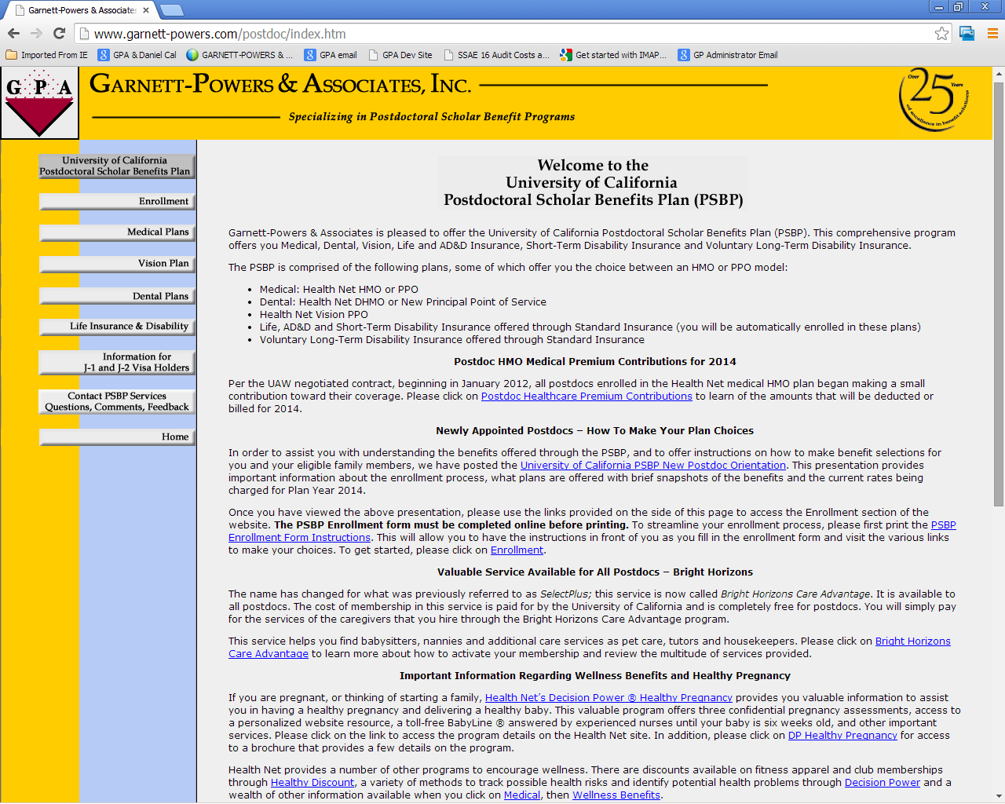

Slide 34
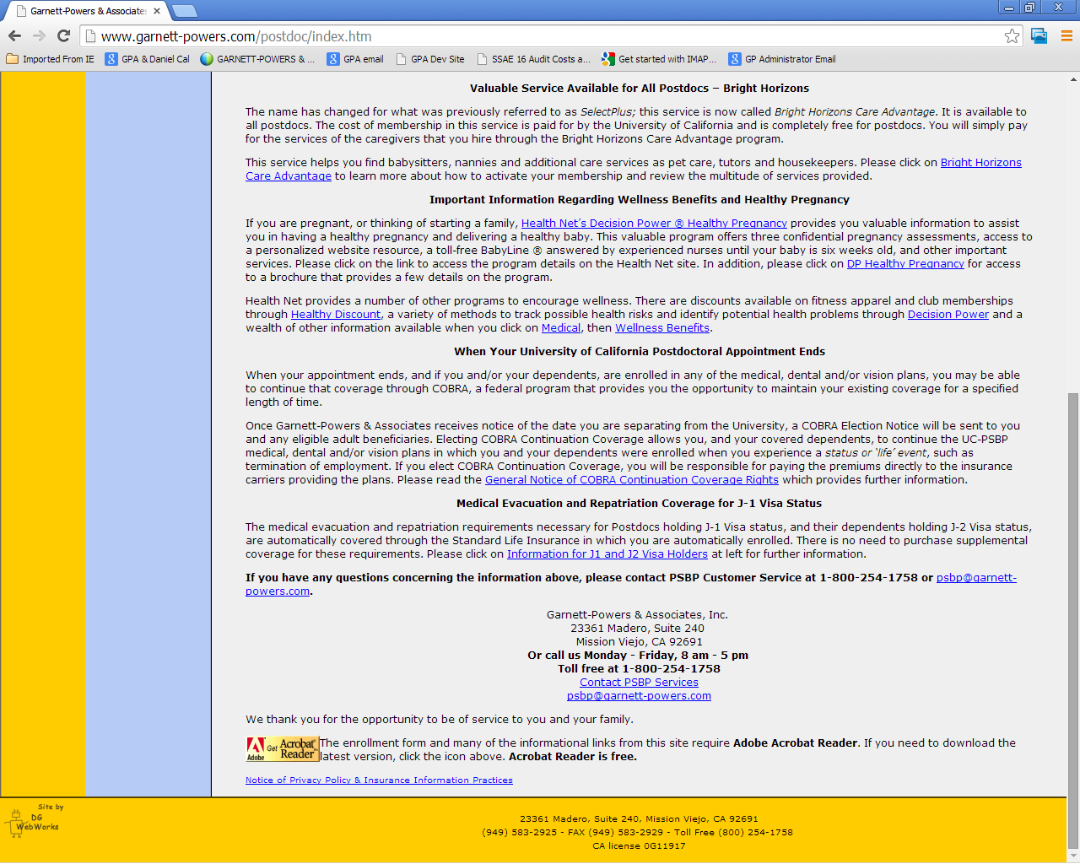

Slide 35
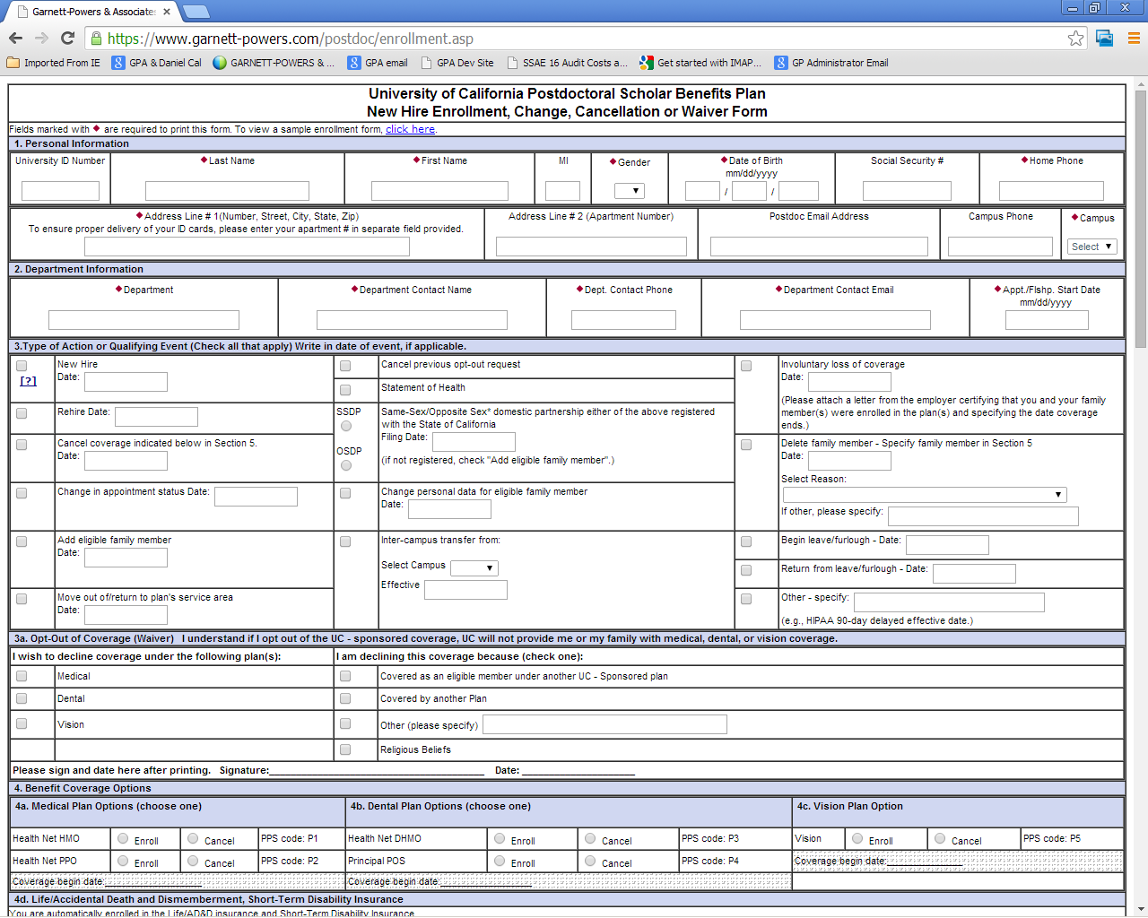

Slide 36
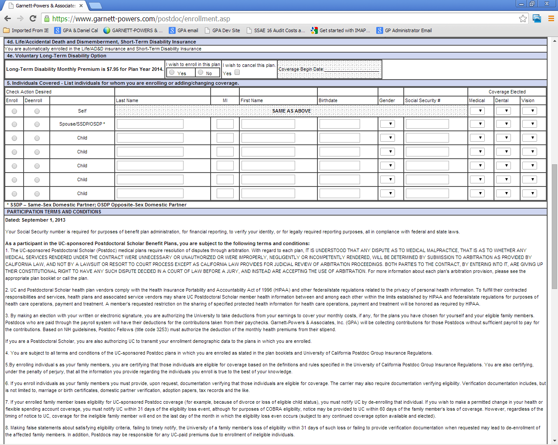

Slide 37
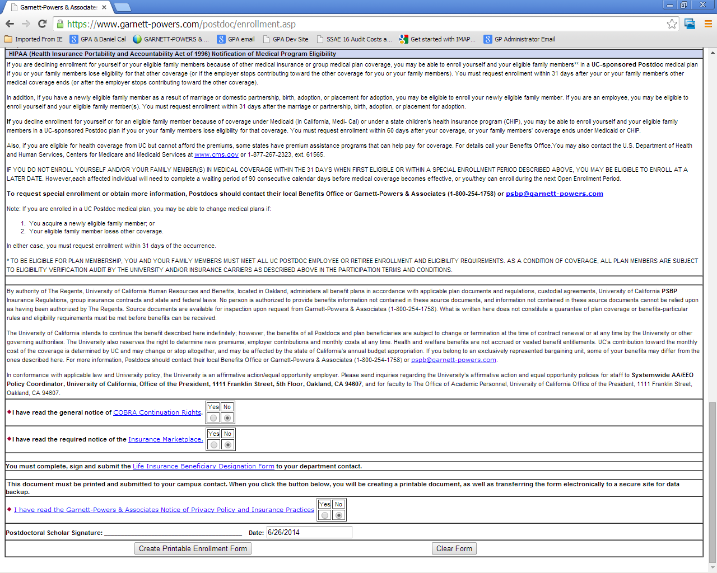

Slide 38
New PSBP Reminders and Handouts

Slide 39
Pop-up Reminder
Please Note: You are not enrolled in benefits until this enrollment/change form is turned in to the appropriate campus administrator and entered into the payroll system.
Email Reminder
Dear, Our records indicate that you completed a Postdoctoral Scholar Benefits Plan Enrollment/Change form recently. If you have not already done so, you must turn this form into the appropriate administrator on your campus. This form needs to be given to the administrator within 31 days of your start date; or, for plan changes, within 31 days of the date of the qualifying event.
You are not enrolled in benefits until the enrollment/change form is turned in to the appropriate campus administrator and entered into the payroll system.
Lisa Walters | Account Manager | Garnett-Powers & Associates

Slide 40
Contact Information
Nadine Fishel
UCOP – Labor Relations
Nadine.fishel@ucop.edu
(510) 987-0434
Jeff Ho
UCOP – Benefits
Jeffrey.Ho@ucop.edu
(510) 987-9813
Steve Johnson
Garnett-Powers – University Services
stevejohnson@garnett-powers.com
(949) 583-2925 #403

